Slide 1
Tele-Wrist: A 4-DOF End-Effector with Haptic Feedback for Robot-Assisted Surgery
Anaya Bhammar, Abi Elangovan, Hunsi Jayaprakash , Sonali Patel
Notes:
Hunsi

Slide 2
01
Background
Teleoperated Surgery and the BILK System

Slide 3
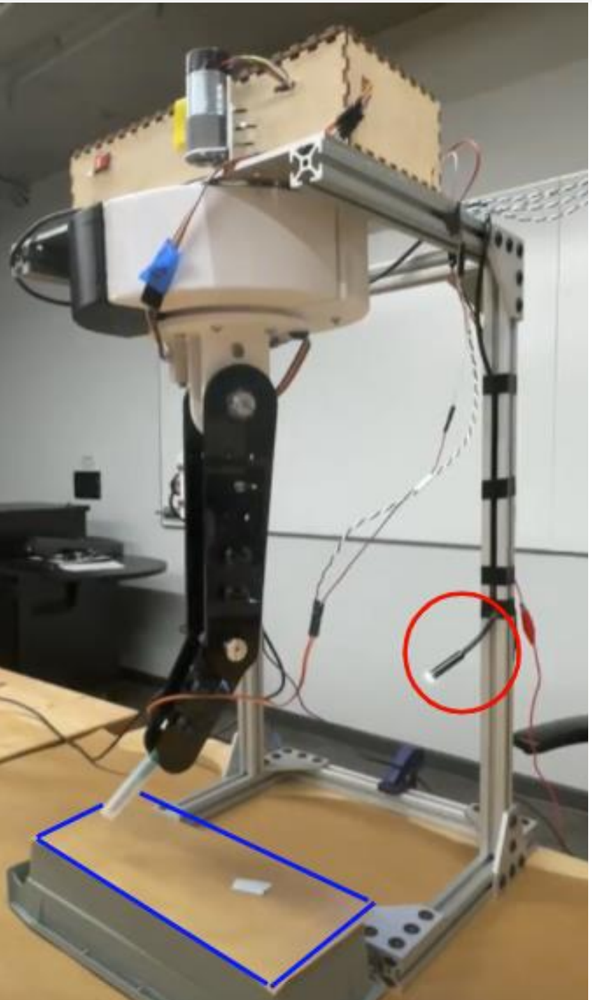
Background: Teleoperated Surgery
History
Teleoperated surgical robots allow doctors to perform complex surgeries via a follower arm and a master arm
BILK Overview
4R surgical manipulator successfully followed desired surgeon trajectories with ε< 0.2” Euclidean distance end effector
Low-Cost
Fig 1: BILK System
Notes:
Hunsi
Teleoperated surgical robots allow surgeons to make precise surgical movements and perform complex surgeries
They consist of a follower arm and a master arm
An example of the Teleoperated surgical robot is the BILK, a previously designed and implemented 4 Rotation surgical manipulator
Which successfully followed a surgeon’s desired trajectory with an error of less than 0.2 “ Euclidean distance end-effector , additionally the BILK is low-cost ; however

Slide 4
Background: BILK System
Limitations:
4R + 1 DOF End Effector
Limited motion
Lacks interchangeability of desired surgical tools
Haptic Feedback
Lacks providing users with sense of interaction
Notes:
Hunsi

Slide 5
Background: Clinical Need & Proposal
Clinical Need
Enhancing operational versatility and surgeon control.
Importance of force feedback in delicate surgical procedures.
Necessity for multi-functional end-effectors in complex surgeries
Our Proposal:
A 4 DOF End Effector with Haptic Feedback and Modular Design
Notes:
Hunsi

Slide 6
02
System
3 DOF Ball Joint, 1 DOF Gripper, Haptic Feedback
Notes:
Abi

Slide 7
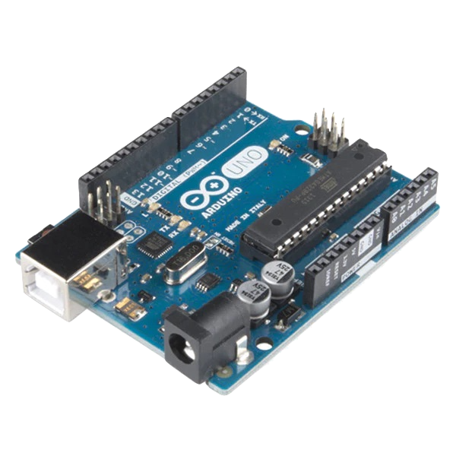
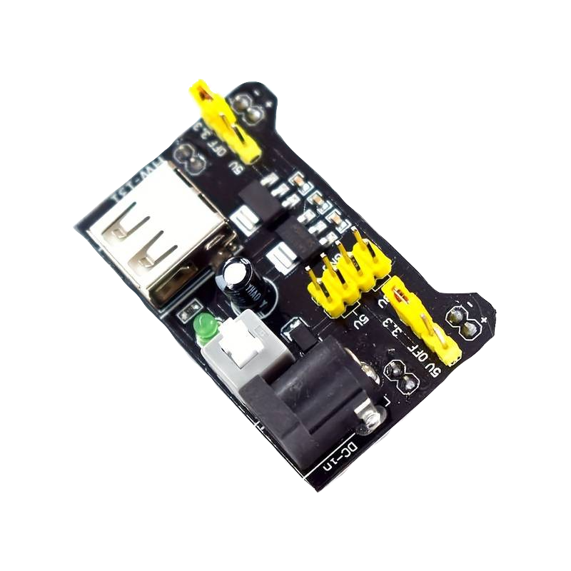
System: High-Level Hardware
Boards
Arduino Uno (x2)
Fig 3: Arduino Uno
Communication
I2C: Low latency
Proposed Bluetooth: Complete - but introduced lag
Power Supply
9V Battery (x3) → HW 131 Power Supply Module (x3)
Fig 4: HW 131
Notes:
Abi

Slide 8
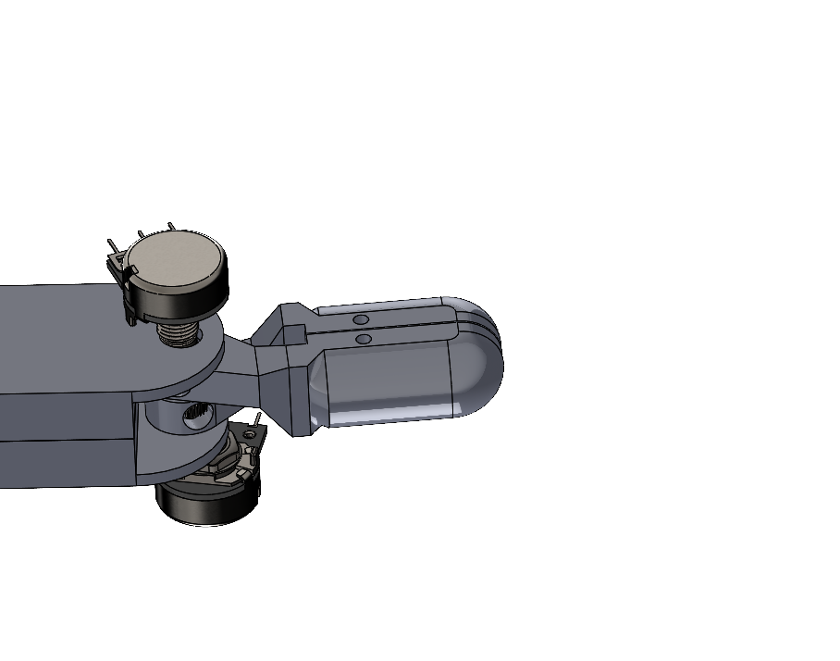
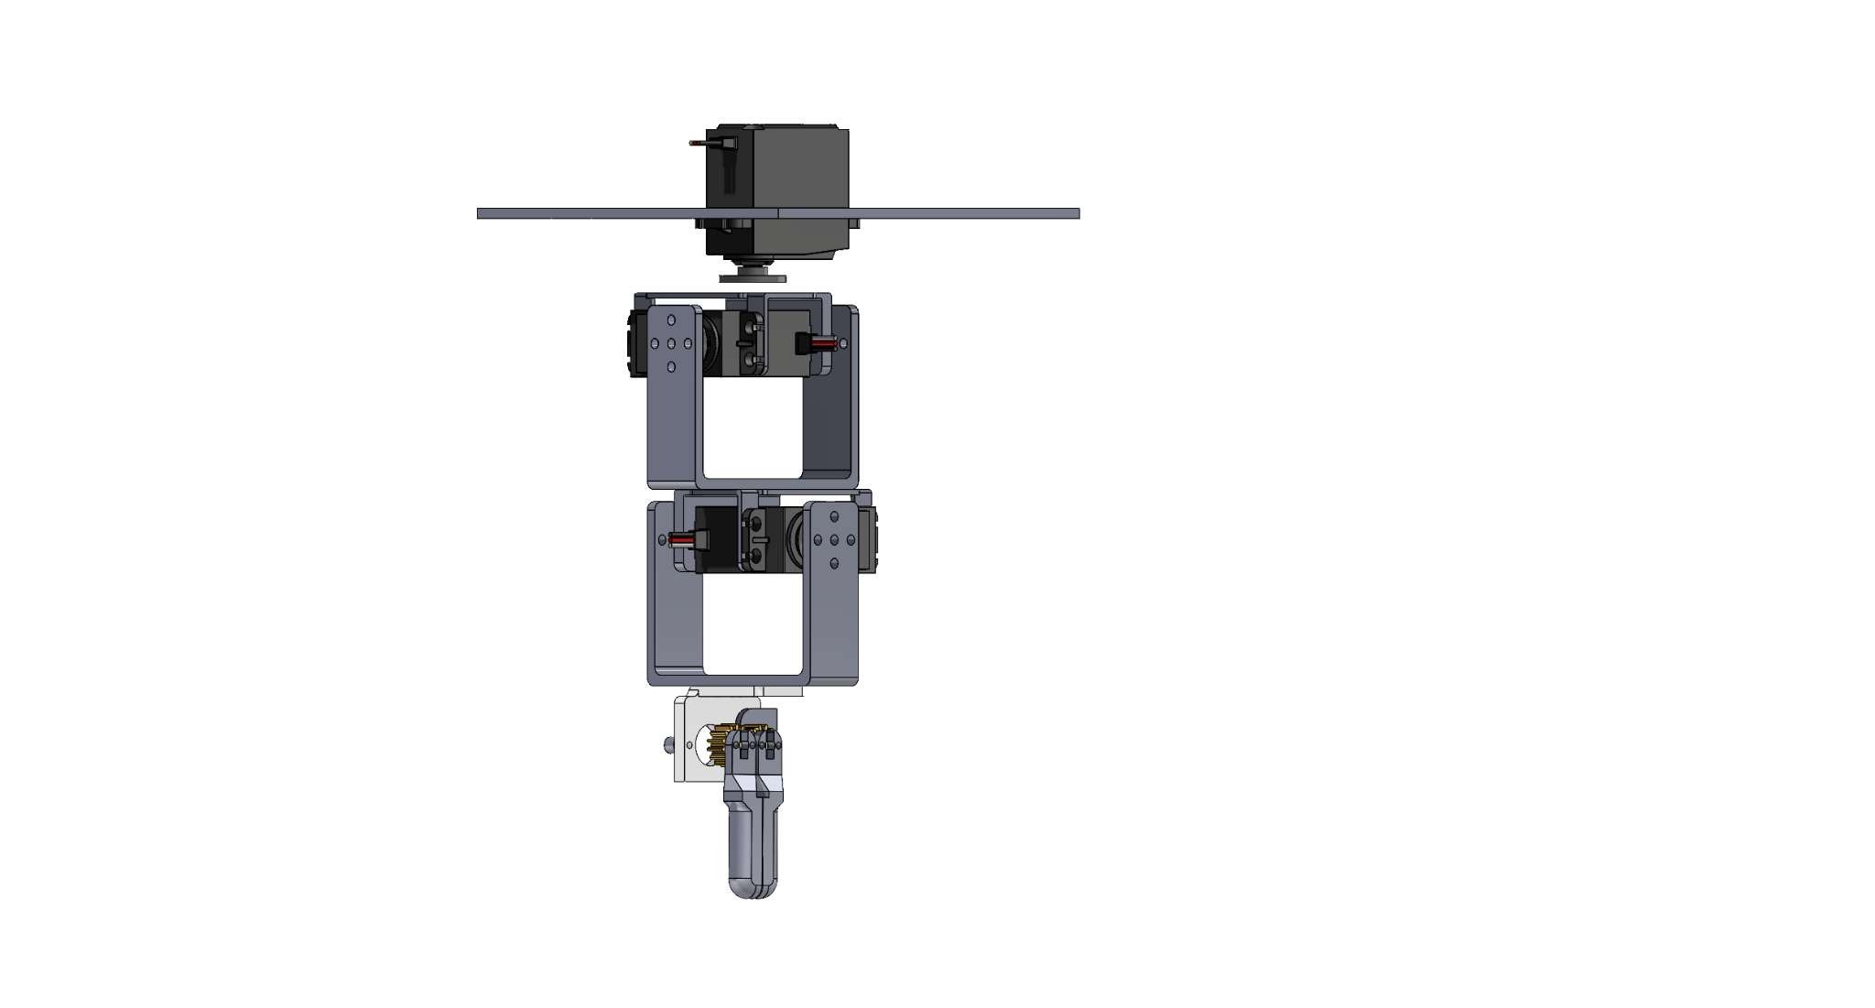
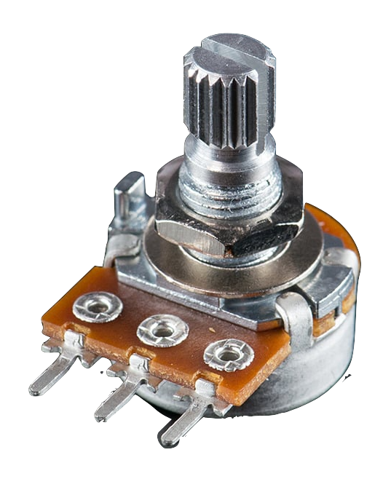
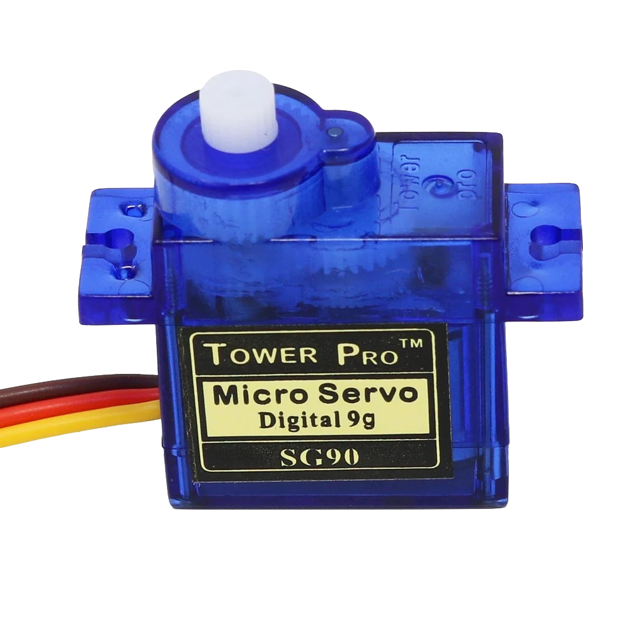
System: Gripper
Master: Finger Tracking
Follower:
Servo Control
10k Potentiometer
Attaches to one gripper arm
SG90 9g Microtower Servo
Attaches to micro servo and uses gears to control movement of arms
Fig 7: Master gripper and potentiometer integration
Fig 8: Follower gripper and servo integration
Notes:
Abi

Slide 9
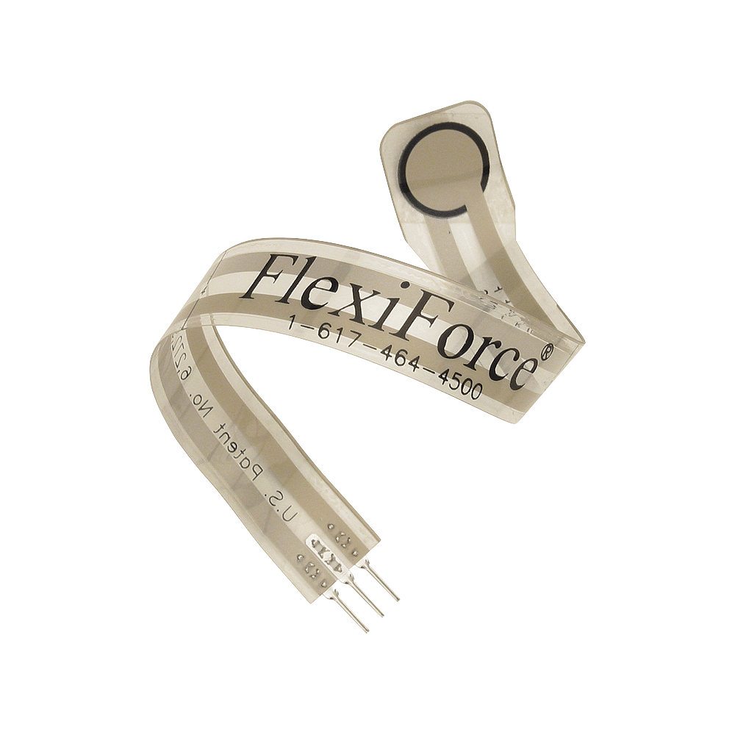
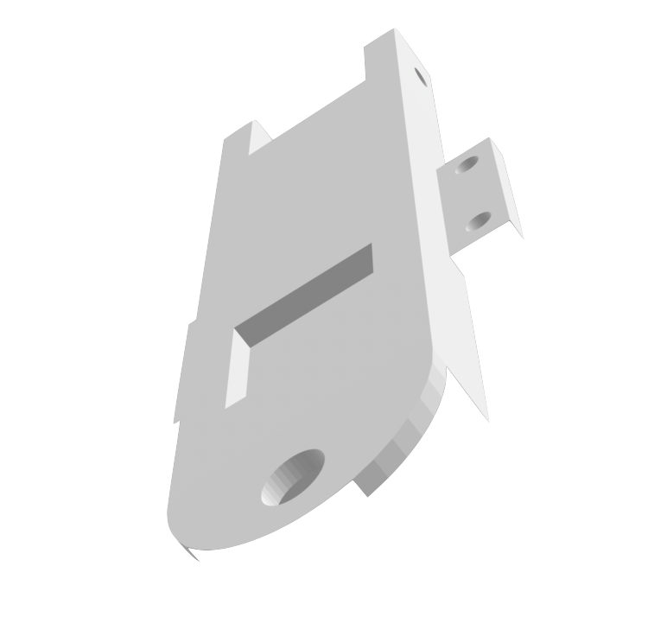
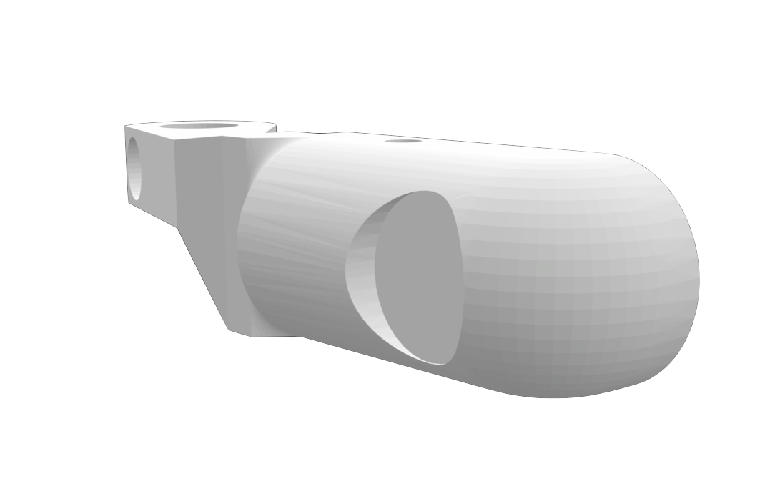
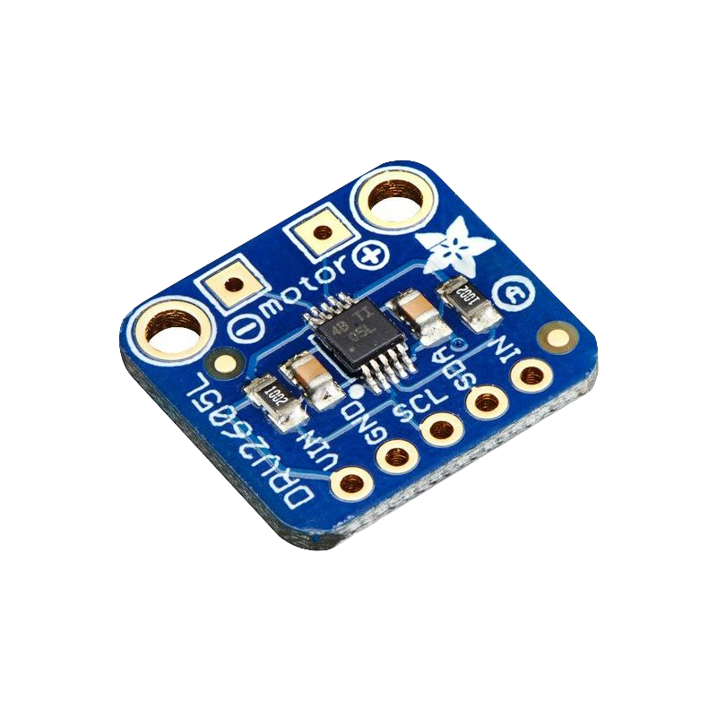
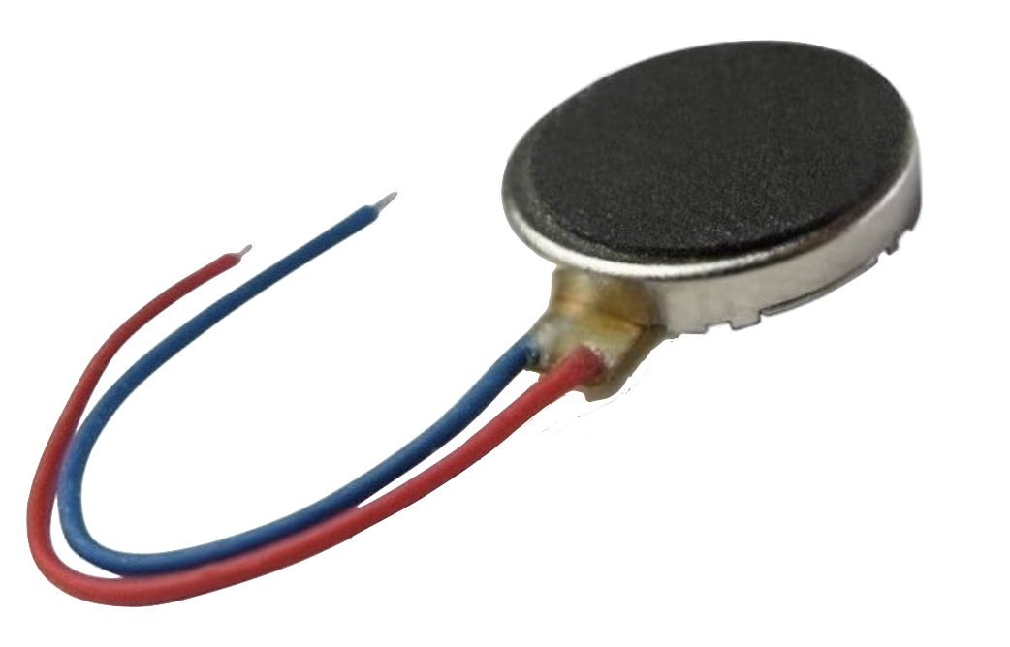
System: Haptic Feedback
Master: Haptic Feedback
Follower:
Force Sensing
Haptic Motor Driver
Haptic Disc Motor
FlexiForce Pressure Sensor
Fig 9: a. Master Gripper and Haptic Motor Driver and Disc Integration
Fig 10: a. Follower end-effector pressure sensor
Notes:
Abi
Add pictures of gripper/force sensor mount
Haptic Motor Controller
Frequency of vibration is determined by how fast the motor spins → PWM signal
Creates a wide range of tactile sensations
Flexiforce pressure sensor
Direct sensing approach measures the force at the distal end-effector
Enhanced tactile feedback via force applied by the end-effector

Slide 10
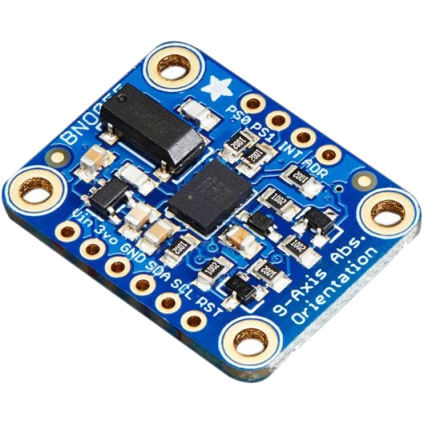
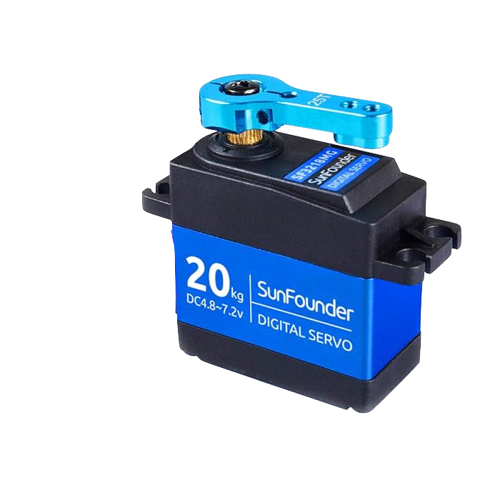
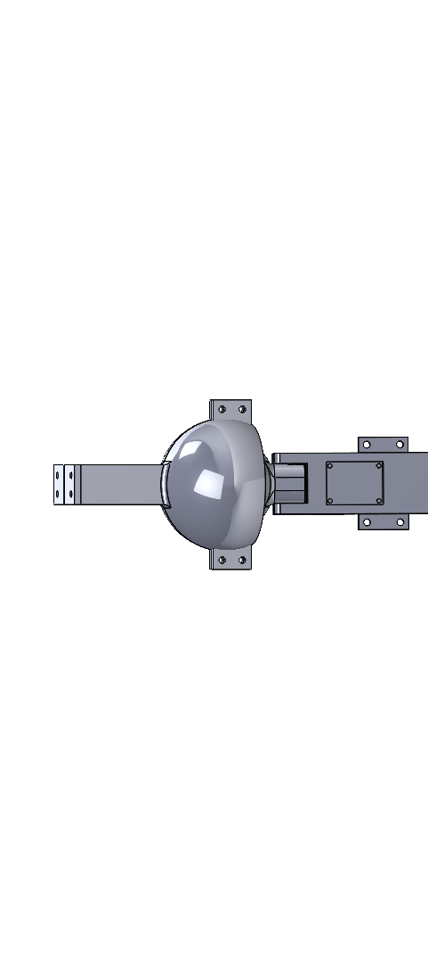
System: Roll, Pitch, Yaw
Master: Wrist Motion
Follower: Servo Control
Adafruit BNO055 Absolute Orientation Sensor (x1) → Euler angles
Ball Joint mimics wrist motion
SunFounder Digital Servo, 20KG (x3)
Euler angles → Respective servo
Modular design for desired DOFs
a.
a.
b.
b.
Fig 5: a. IMU b. Ball Joint
Fig 6: a. Servo b. Servo Mount
Notes:
Abi

Slide 11
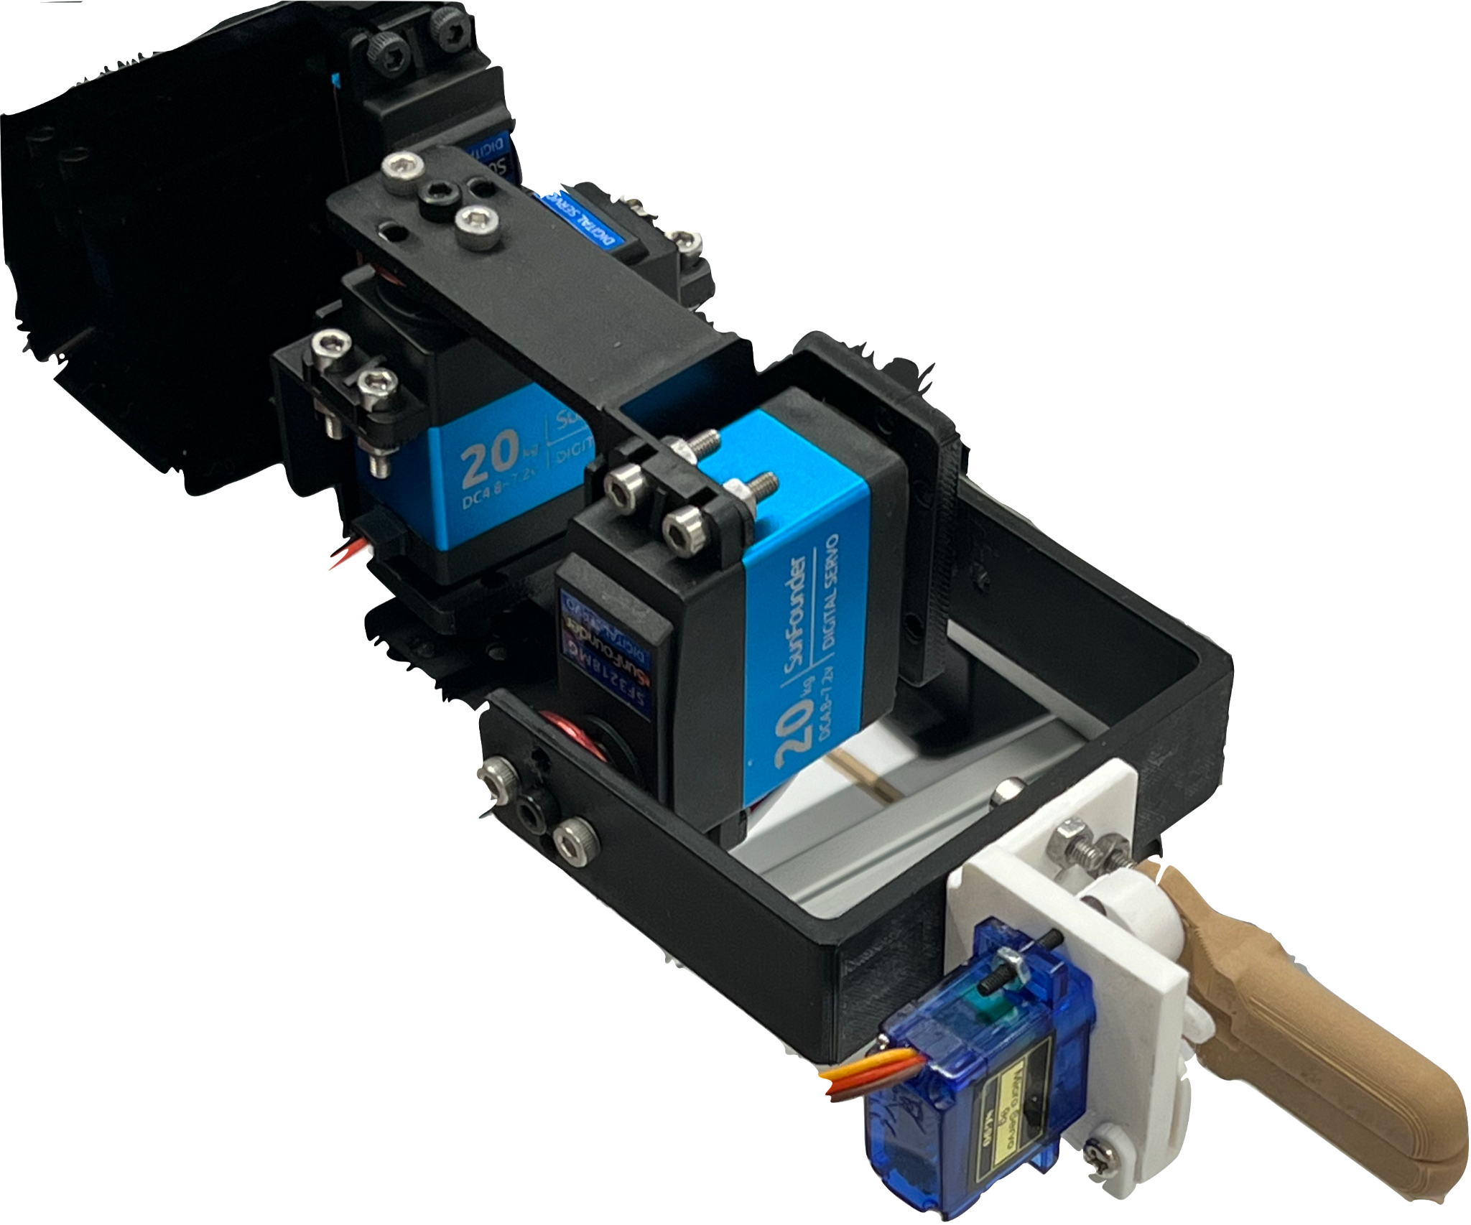
System: IMU to Servo Mapping
0°
Yaw
90°
0°
360°
Roll
180°
0→180
180°
Yaw
-90 →90
90°
0°
180°
-180 →180
-90°
-90°
Pitch
90°
Roll
Pitch
+90°
+90°
0°
Notes:
Abi

Slide 12
03
Evaluation and Results
Position Accuracy, Gripper, and Haptic Feedback
Notes:
Sonali
Introduce evaluation and results
For our evaluation and results we did three tests to evaluate our design. The first being position accuracy, second maneuverability and grip and third haptic feedback. I will overview the position accuracy evaluation and takeaways and introducethe manueverability and grip tests.

Slide 13
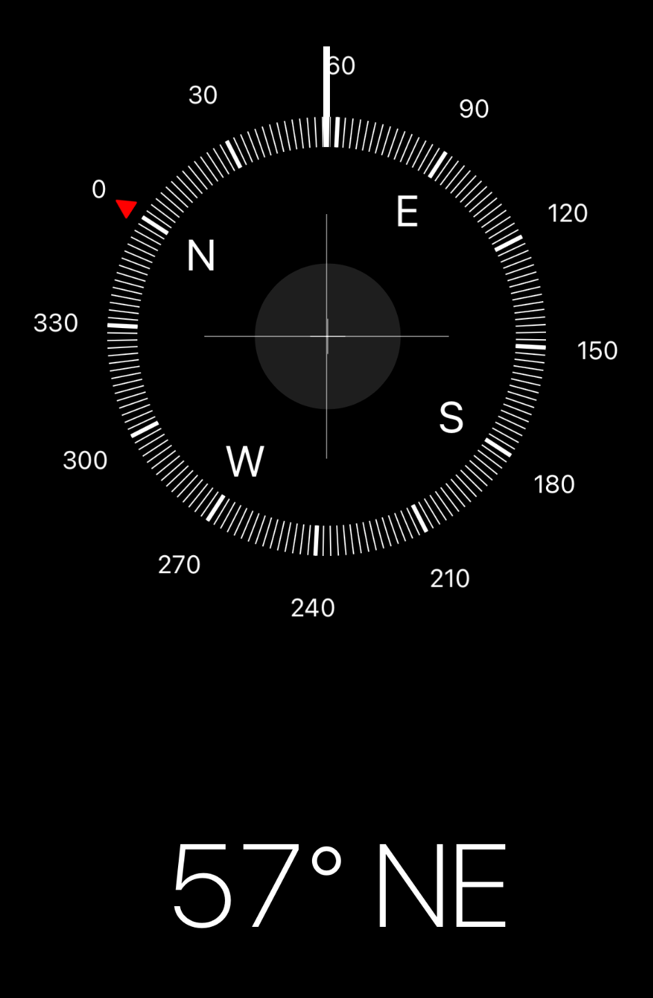
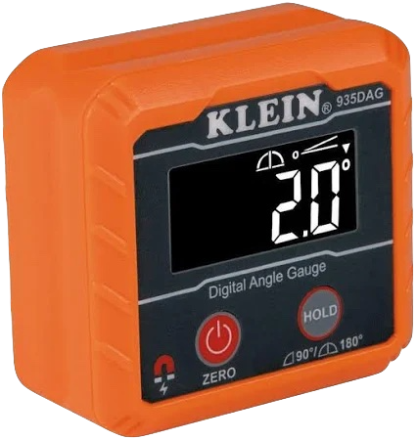
Evaluation: Position Accuracy
Compared Observed, IMU, and Servo angles:
Evaluated error in IMU and Master to Follower mapping via digital angle gauges/compass measurements
Roll: ± 4°
Pitch: ± 6 °
Yaw: ± 11 °
Fig 11: Measurement Devices Used
Within reasonable error, the IMU and Follower were able to mimic Roll, Pitch, and Yaw of Master.
Notes:
Sonali
The first is position accuracy test. Once the user moves the master we want to evaluate how well the IMU picks up these angle and then maps them to the follower arm. We investigated the roll pitch yaw angles by isolating movements and measuring the angle between the axial zero heading for each of the directions and the position of the master, and follower arm.
We first calibrated the system
Then we directed the master arm into a certain position (for roll pitch and yaw we measured the extreme angles for which the master arm was able to be directed towards
We then directed the arm to three random angles in the middle
What we measured was the angle of the master, IMU, and follower angle
For Roll and pitch we implemented a digital angle gauge
For yaw we used our phone’s compass and found the differences in the heading of the arms vs. the

Slide 14
Conclusion: Position Accuracy
Position Accuracy Method
Roll had the highest position accuracy
Roll servo is placed in a stable position
Roll was measured around a stable axis point
Yaw had the lowest position accuracy
Likely due to accumulated drift over time
Limitations:
Use the phone compass for yaw measurement
Angle gauge and phone were held as close to the arm and servo brackets as possible
Notes:
Sonali
Also important to note that over time we observed that due to gravity and the weight of the follower arm, the zeroed position slightly points below level pitch
For these reasons we measured and implemented the offset of this pitch angle into our calcualitons, assuming that if the follower arm was more stable the correct angle would be what we measured

Slide 15
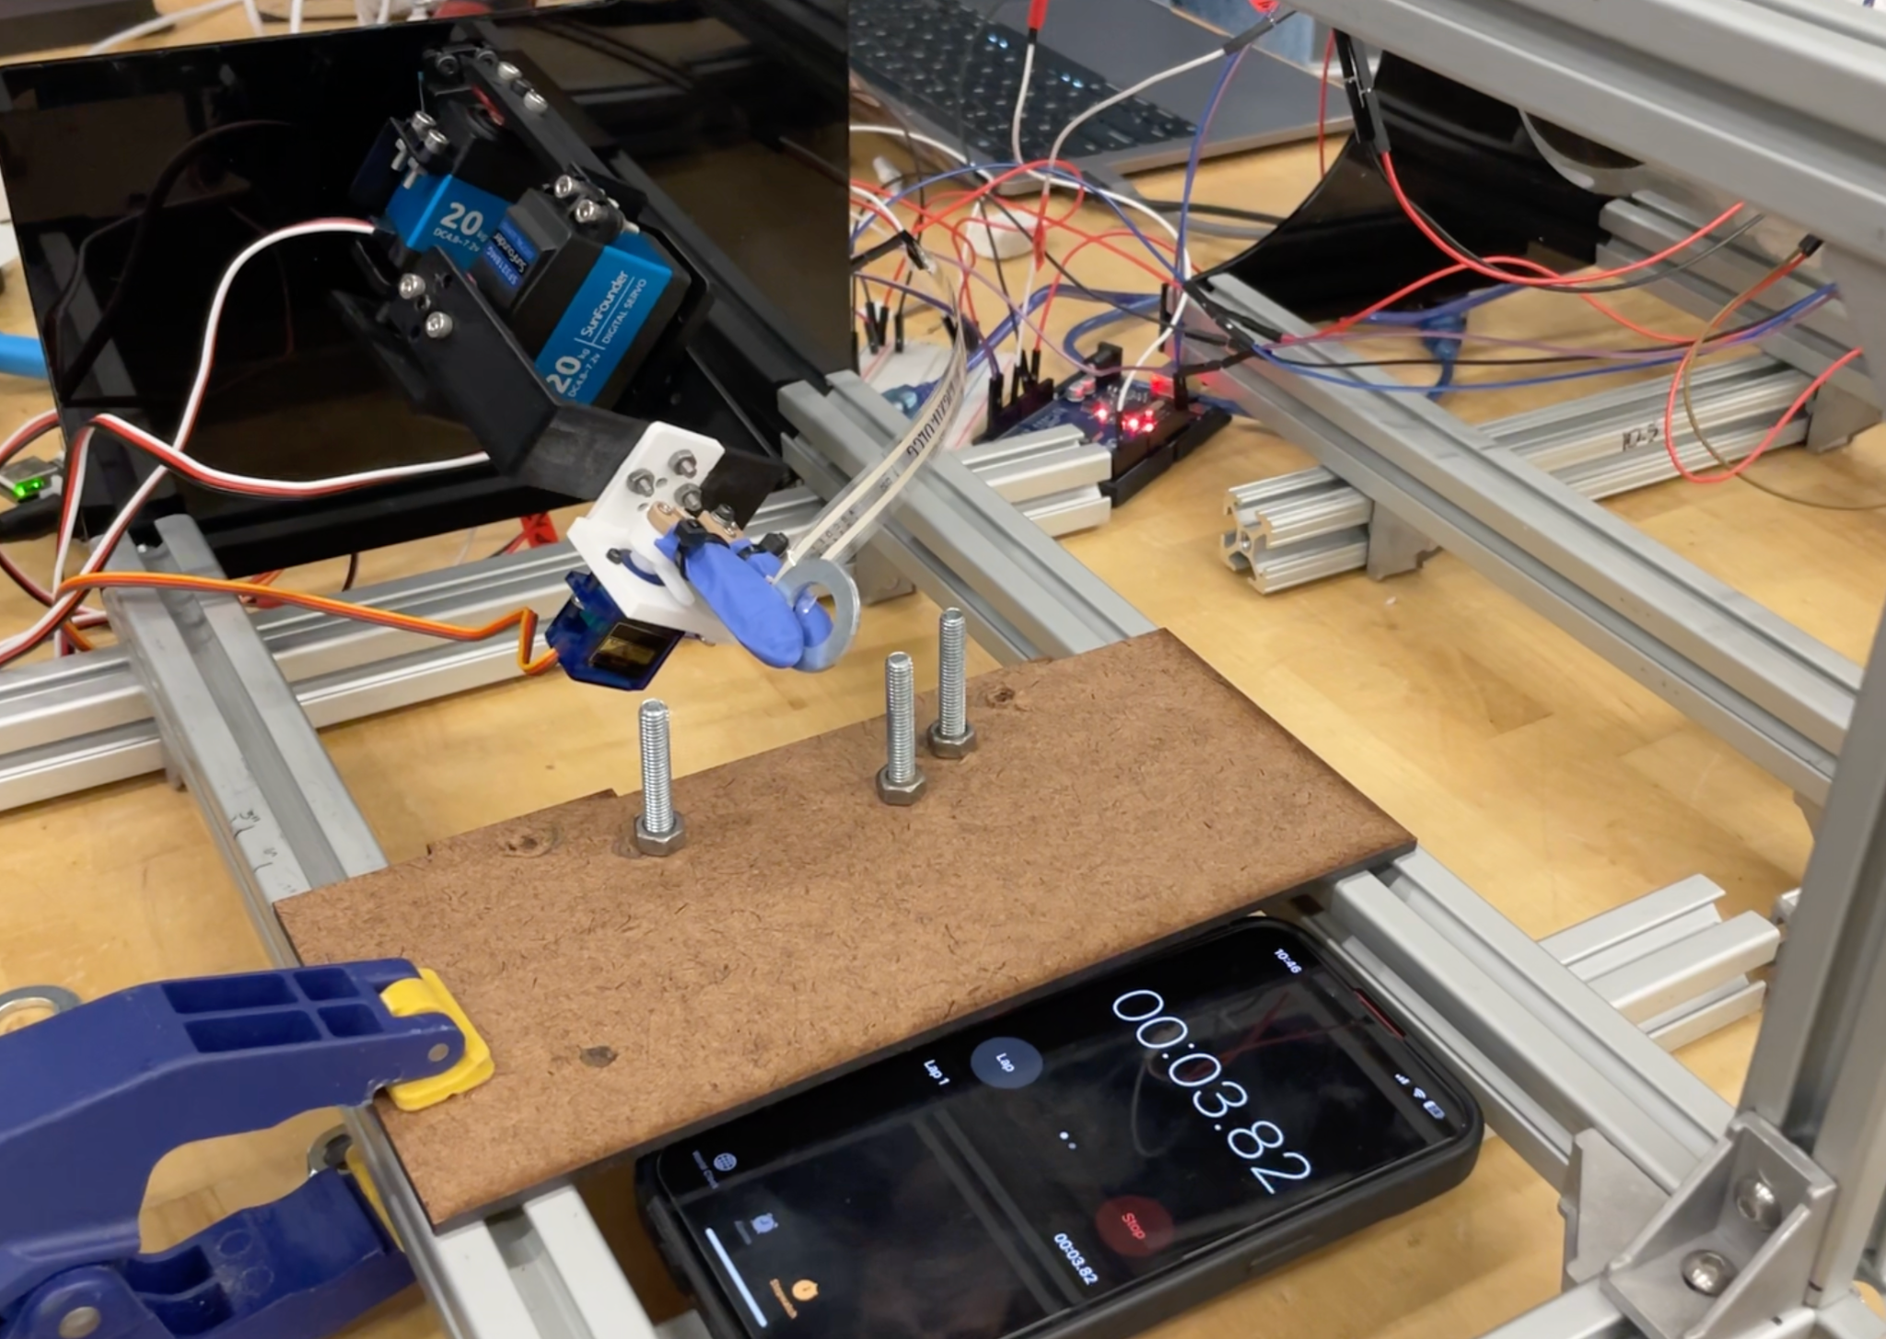
Evaluation: Maneuverability and Grip
Testing via Ring Toss
Evaluate if gripper torque and range of motion of wrist was sufficient to place rings on pegs
Fig 12: Ring Toss Test Set-up
Notes:
Sonali
Slip
Variability of where washer was placed inside the gripper arms

Slide 16
Evaluation: Maneuverability and Grip
Testing via Ring Toss
User | Time (Seconds)
Hunsi (Experienced User - 5+ Trials) | 38
Sonali (New User) | 69
Anaya (New User) | 75
Users are capable of accurately manipulating in 4DOF, with accuracy improving with experience. Grip varies with initial positioning. Range would benefit from 2DOF provided by BILK integration.
Notes:
Add pictures
Slip
Variability of where washer was placed inside the gripper arms

Slide 17
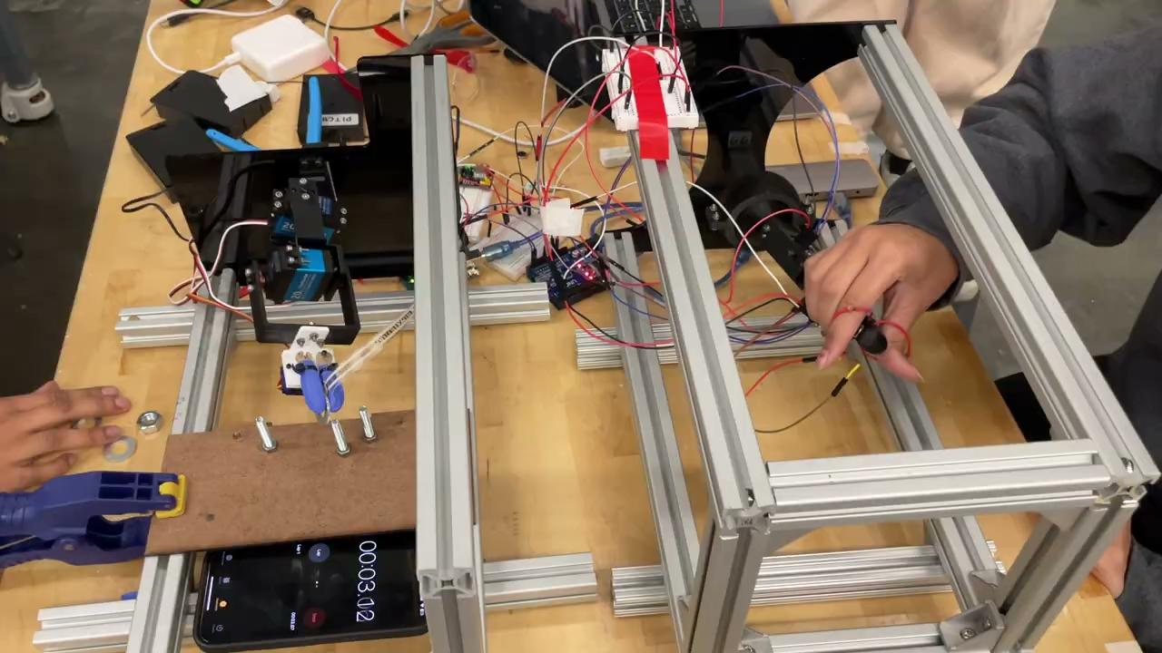
Notes:
Ring Toss video
User interfacing with master arm and placing two washers on the pegs

Slide 18
Conclusion: Maneuverability and Grip
Maneuverability and Grip
Allowed for testing mobility of all servos at once including the gripper servo
Hunsi completed the task the fastest
Had the most experience with the system
Learning about system greatly affects the performance during the ring toss task
Limitations:
Tested the system with users of varying experience
System would halt once calibration values were not met
Caused delay in task completion
Caused loss of control of grip on ring
Notes:
Add pictures

Slide 19
Evaluation: Haptic Feedback
Force Reading
0
50
100
200
400
400+
Haptic Level
1 : 20%
2 : 40%
3 : 60%
4 : 80%
5 : 100%
Material | Elastic Modulus (GPa) | Thickness (in.) | Max Force Reading | Haptic Vibration Level
Polyolefin | 2.5 | 5.1875 | 153 | 3
Clay | 8 | 5.125 | 212 | 4
Based on stiffness test, stiffer material outputted higher compressive forces and stronger haptic vibrations at the master.
Notes:
Add pictures

Slide 20
Conclusion: Haptic Feedback
Haptic Feedback
Haptic feedback at different levels is perceived by user
Surgeons can gauge force level from master arm
Force sensor integration with slave arm allows for real-time feedback
Limitations:
Integration with slave arm gripper could be improved
Haptic feedback perception needs to be measured with different materials
Notes:
Add pictures

Slide 21
Evaluation: Position Accuracy ~ Roll
IMU Mapped Euler Angle Initial Heading = 207 | Observed Master Angle | Delta IMU Mapped and Observed Master Angle | Observed Follower Angle | Observed Master Angle | Delta Observed Master and Follower Angle
90 | 89 | (+) 1 | 86 | 89 | (-)3
48 | 49 | (+) 1 | 47 | 49 | (+) 2
-40 | -37 | (+) 3 | -36 | -37 | (-) 1
-52 | -56 | (-) 4 | -52 | -56 | (+) 4
-74 | -76 | (-) 2 | -76 | -76 | (+) 0
Notes:
Add pictures

Slide 22
Evaluation: Position Accuracy ~ Pitch
IMU Mapped Euler Angle | Observed Master Angle | Delta IMU Mapped Euler Angle & Observed Master | Observed Follower Angle | Delta Observed Master and Follower Angle
38 | -40 | (-) 2 | -40 | (+)0
31 | -31 | (-) 0 | -31 | (+) 0
-22 | 22 | (+) 0 | 20 | (-) 2
-29 | 36 | (+) 7 | 28 | (-)8
-37 | 43 | (+) 6 | 36.5 | (-)6.5
Notes:
Add pictures , correction

Slide 23
Evaluation: Position Accuracy ~ Yaw
IMU Mapped Euler Angle 198 Heading | Observed Master Angle 0=270 | Delta IMU Mapped and Observed Master Angle | Observed Follower Angle | Delta Observed Master and Follower Angle
251 | 29 | (+) 24 | 37 | (-) 8
239 | 49 | (+) 8 | 41 | (+)8
221 | 19 | (-) 4 | 22 | (-) 3
172 | 29 | (-) 3 | 30 | (-)1
169 | 43 | (-) 6 | 33 | +(10)
Notes:
Add pictures

Slide 24
04
Integration with BILK
DOF Integration and Mounts

Slide 25
04
Future Work
Bluetooth, Power Supply, Servo Smoothing

Slide 26
Future Work: Overall
Communication
Implement Bluetooth Connection between Master and Follower Arm
Mechanical
Improve mechanical rigidity of servo brackets
Allow for independent gripper motion
Improve slipping on slave gripper by increasing friction
Streamline wiring for master hand ergonomics
Shortening and integrating force sensor
Electrical
Utilize voltage converters to power off of BILK power supply
Use Alorium XLR8 Board for servo smoothing
Notes:
Hunsi

Slide 27
Thank You!

Slide 28
References
BILK Final Report 2021 and 2022
https://ieeexplore.ieee.org/abstract/document/8322289
https://inria.hal.science/hal-04122655/document
https://iopscience.iop.org/article/10.1088/1757-899X/1012/1/012006/pdf
https://adam-meyer.com/arduino/Flexiforce
https://www.allaboutcircuits.com/projects/bosch-absolute-orientation-sensor-bno055/

